Slide 1
UNITED NATIONS GLOBAL GEODETIC
CENTRE OF EXCELLENCE
MODERNISING GEOSPATIAL REFERENCE SYSTEM
CAPACITY DEVELOPMENT WORKSHOP
EXAMPLE: Creating transformation parameters
Nicholas Brown
Head of Office, UN-GGCE
Day 3, Session 1 [3_1_2]
HOW
Acknowledgements: John Dawson (AUS); Guorong Hu (AUS).

Slide 2
Computing transformation parameters
Fiji’s datum is WGS72
The Pacific Islands Applied Geoscience Commission (SOPAC) requested Geoscience Australia to compute International Terrestrial Reference Frame (ITRF) coordinates for 18 survey sites on islands in the northern Fiji archipelago from continuous geodetic Global Positioning System (GPS) measurements observed from 8th July to 5th August 2008 inclusive.
These coordinates provide the coordinate reference frame to be used to define Fiji’s claim to extended continental shelf under the provisions of Article 76 of the United Nations Convention on the Law of the Sea
STRONGER.
TOGETHER.

Slide 3
Computing transformation parameters
Static Datum
ITRF2005@2008
7 parameter transformation
Static Datum
WGS72
STRONGER.
TOGETHER.

Slide 4
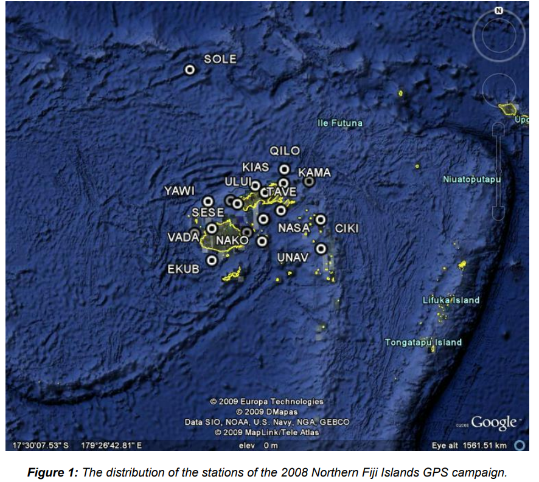
Computing transformation parameters
1. Observe GNSS on marks on which WGS72 coordinates are available
18 stations
Dual freq. observations
28 days continuously
STRONGER.
TOGETHER.
Dawson and Hu (AUS)

Slide 5
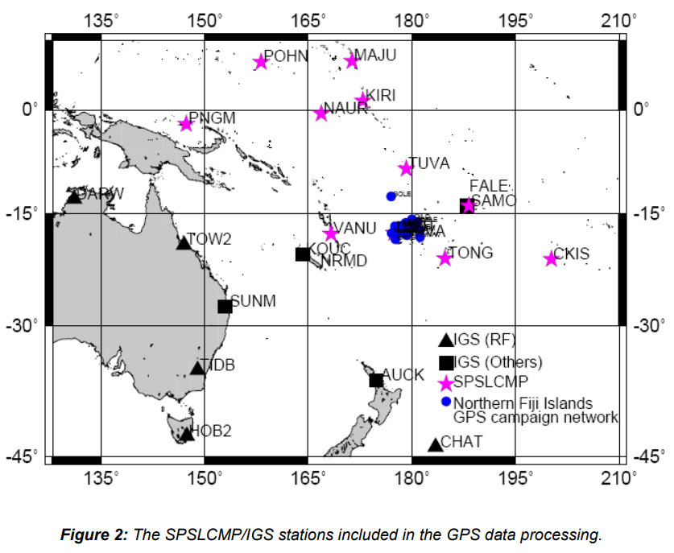
Computing transformation parameters
2. Process GNSS data to compute ITRF2005@2008 coordinates
Included 5 IGS stations from the surrounding area in the processing (to align / constrain to ITRF)
Also included Pacific Island regional reference sites to “aid ambiguity resolution and to reduce baseline lengths between the above IGS stations and the Fiji campaign stations”.
Dawson and Hu (AUS)
STRONGER.
TOGETHER.

Slide 6
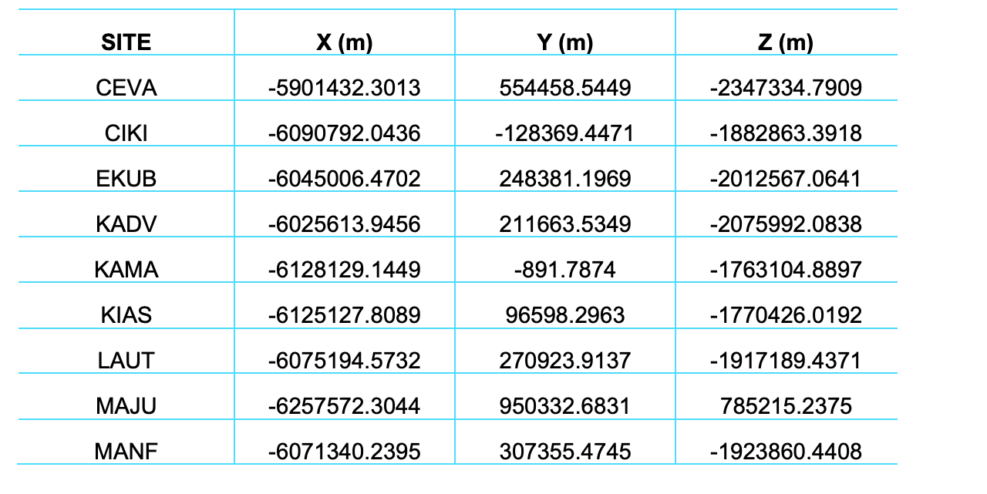
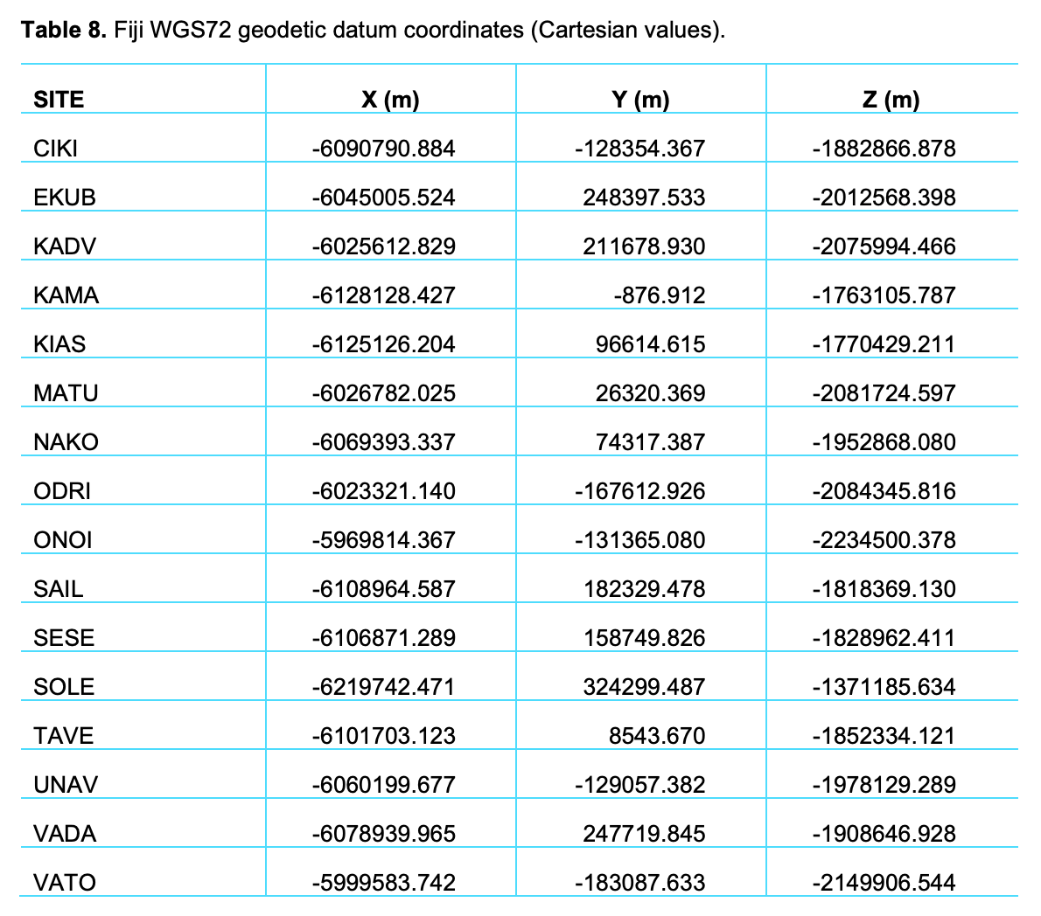
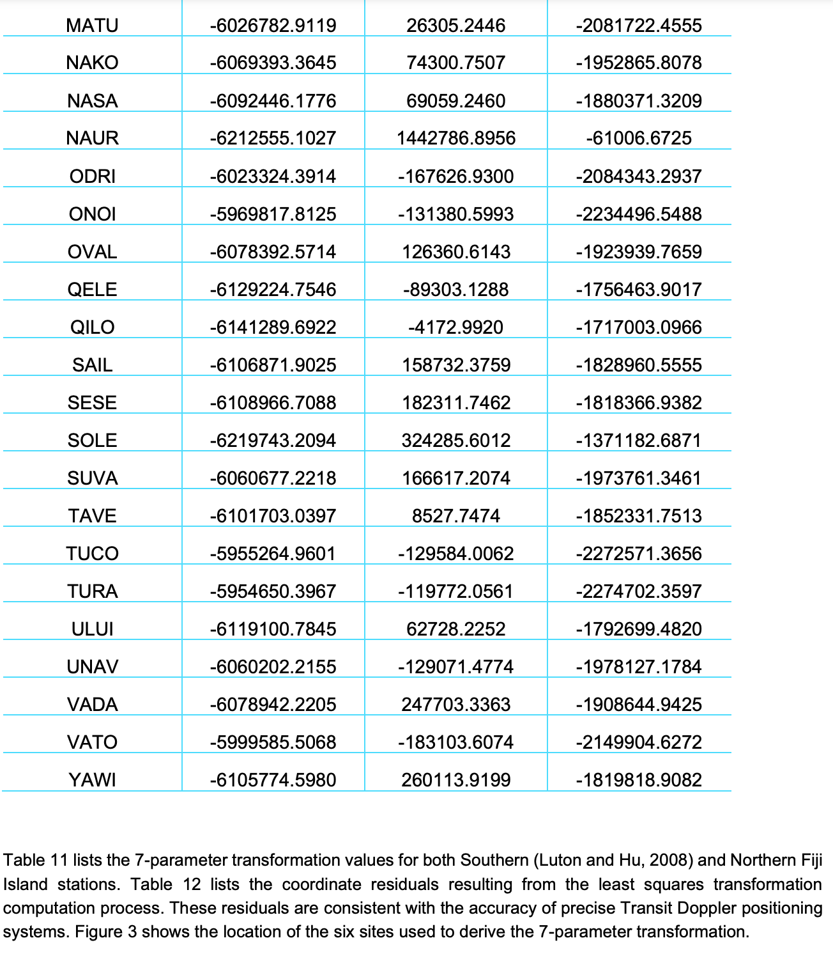
Computing transformation parameters
ITRF2005@2008
WGS72

Slide 7
Computing transformation parameters
STRONGER.
TOGETHER.

Slide 8
Computing transformation parameters
Need at least 3 common points; but the more you have the better
The transformation parameters are computed using a least squares adjustment process
Translation Parameters (𝑇𝑥,𝑇𝑦,𝑇𝑧):
Compute the mean difference between corresponding coordinates of Datum 1 and Datum 2 to get initial translation values.
Scale Factor (𝑠):
Estimate the scale change as the ratio of the distances between points in Datum 2 and Datum 1.
Rotation Parameters (𝑅𝑥,𝑅𝑦,𝑅𝑧):
Compute the rotation angles that best align Datum 1 with Datum 2. This involves solving for the rotation matrix 𝑅 using a linearized form of the transformation equations.
STRONGER.
TOGETHER.

Slide 9
Computing transformation parameters
Solve the Linearized System
Set up a system of equations:
Δ=𝐴⋅𝑃
Δ: The differences between the observed and transformed coordinates.
𝐴: The design matrix (based on partial derivatives of the transformation equations).
𝑃: The unknown parameters (𝑇𝑥,𝑇𝑦,𝑇𝑧,𝑅𝑥,𝑅𝑦,𝑅𝑧,𝑠).
Iteratively Refine the Parameters
Solve for 𝑃 using matrix operations (e.g., 𝑃=(𝐴^{𝑇}𝐴)⁻¹𝐴^{𝑇}Δ
Apply the estimated parameters to the input data.
Refine the estimates until residuals are minimized.
Verify the Transformation
Use the computed parameters to transform the original coordinates.
Compare the transformed coordinates with the target datum to ensure accuracy.
This can be done in GNSS Combination Software (e.g. CATREF), proprietary software … or with assistance from AI
STRONGER.
TOGETHER.

Slide 10
Computing transformation parameters
WGS72
ITRF2005@2008
X Y Z
X Y Z
-6090790.9 -128354.37 -1882866.9 -6090792 -128369.45 -1882863.4
-6045005.5 248397.533 -2012568.4 -6045006.5 248381.197 -2012567.1
-6025612.8 211678.93 -2075994.5 -6025613.9 211663.535 -2075992.1
-6128128.4 -876.912 -1763105.8 -6128129.1 -891.7874 -1763104.9
-6125126.2 96614.615 -1770429.2 -6125127.8 96598.2963 -1770426
-6026782 26320.369 -2081724.6 -6026782.9 26305.2446 -2081722.5
-6069393.3 74317.387 -1952868.1 -6069393.4 74300.7507 -1952865.8
-6023321.1 -167612.93 -2084345.8 -6023324.4 -167626.93 -2084343.3
-5969814.4 -131365.08 -2234500.4 -5969817.8 -131380.6 -2234496.5
-6108964.6 182329.478 -1818369.1 -6108966.7 182311.746 -1818366.9
-6106871.3 158749.826 -1828962.4 -6106871.9 158732.376 -1828960.6
-6219742.5 324299.487 -1371185.6 -6219743.2 324285.601 -1371182.7
-6101703.1 8543.67 -1852334.1 -6101703 8527.7474 -1852331.8
-6060199.7 -129057.38 -1978129.3 -6060202.2 -129071.48 -1978127.2
-6078940 247719.845 -1908646.9 -6078942.2 247703.336 -1908644.9
-5999583.7 -183087.63 -2149906.5 -5999585.5 -183103.61 -2149904.6
STRONGER.
TOGETHER.

Slide 11
Computing transformation parameters
AI results
Dawson and Hu results
Translations (meters):
Tx= -6.9344
Ty= -21.2037
Tz= -10.4443
Scale factor (unitless):
S= -1.42 ppm
Rotations (arcseconds):
Rx= -0.1225
Ry= 0.3425
Rz= -0.2289
Translations (meters):
Tx= -7.0295
Ty= -22.1185
Tz= -10.1505
Scale factor (unitless):
s= -1.4227 ppm
Rotations (arcseconds):
Rx= -0.1139
Ry= +0.3325
Rz= -0.2573
ChatGPT RMSE residuals
Dawson and Hu RMSE residuals
X: 0.887 m
Y: 1.038 m
Z: 0.745 m
X: 0.983 m
Y: 0.863 m
Z: 0.808 m
STRONGER.
TOGETHER.

Slide 12
Python code
import numpy as np
def compute_transformation_params(datum1, datum2):
"""
Compute the 7-parameter transformation parameters using least squares.
Parameters:
- datum1: numpy array of shape (n, 3), coordinates in the first datum
- datum2: numpy array of shape (n, 3), coordinates in the second datum
Returns:
- parameters: dict containing translation, rotation, and scale factor
"""
# Ensure data is in numpy array format
datum1 = np.array(datum1)
datum2 = np.array(datum2)
# Compute centroids
centroid1 = np.mean(datum1, axis=0)
centroid2 = np.mean(datum2, axis=0)
# Center the coordinates
centered1 = datum1 - centroid1
centered2 = datum2 - centroid2
# Scale factor (s)
scale = np.sqrt(np.sum(centered2**2) / np.sum(centered1**2))
# Compute the rotation matrix using Singular Value Decomposition (SVD)
H = np.dot(centered2.T, centered1)
U, _, Vt = np.linalg.svd(H)
rotation_matrix = np.dot(U, Vt)
# Translation vector (Tx, Ty, Tz)
translation = centroid2 - scale * np.dot(rotation_matrix, centroid1)
# Extract rotation angles (in radians)
rotation_angles = {
'Rx': np.arctan2(rotation_matrix[2, 1], rotation_matrix[2, 2]),
'Ry': np.arctan2(-rotation_matrix[2, 0], np.sqrt(rotation_matrix[2, 1]**2 + rotation_matrix[2, 2]**2)),
'Rz': np.arctan2(rotation_matrix[1, 0], rotation_matrix[0, 0])
}
# Return parameters
return {
'Translation': translation,
'Rotation (radians)': rotation_angles,
'Scale Factor': scale
}
# Example usage:
# Replace `datum1_coords` and `datum2_coords` with your actual data
datum1_coords = [
[-6090790.884, -128354.367, -1882866.878],
[-6045005.524, 248397.533, -2012568.398],
# Add more points as needed
]
datum2_coords = [
[-6090792.0436, -128369.4471, -1882863.3918],
[-6045006.4702, 248381.1969, -2012567.0641],
# Add more points as needed
]
# Compute transformation parameters
params = compute_transformation_params(datum1_coords, datum2_coords)
# Display results
print("Translation Parameters (Tx, Ty, Tz):", params['Translation'])
print("Rotation Angles (Rx, Ry, Rz) in radians:", params['Rotation (radians)'])
print("Scale Factor:", params['Scale Factor'])
Replace the placeholder data (datum1_coords and datum2_coords) with your actual coordinates from the two datums.
The function will compute the translation, rotation (in radians), and scale factor.
STRONGER.
TOGETHER.

Slide 13
Discussion
What should you consider before using AI?
How could you validate the method?
Who could you ask for assistance?
STRONGER.
TOGETHER.

